Slide 1

Introduction to Machine Learning Topic 1 – What is Machine Learning? (HO Ch. 1 / ISL Ch. 2)
Master in Quantitative Economic Analysis MQuEA
Javier Bas
Universidad Autónoma de Madrid
2023/2024

Slide 2
Outline
What & Why
Examples
Types of Machine Learning methods
Training, Testing, and Performance
The Accuracy-Flexibility trade-off
The Bias-Variance trade-off
Main challenges in Machine Learning practice
Take-home messages
Master in Quantitative Economic Analysis MQuEA
Universidad Autónoma de Madrid

Slide 3
What & Why
How would you define ML?
Can you name four problems where it can be applied?
What is a labeled training set?
Can you name four common supervised tasks?
What type of ML algorithm would you use to allow a robot walk in various unknown terrains?
What type of ML algorithm would you use to segment your customers into multiple groups?
Master in Quantitative Economic Analysis MQuEA
Universidad Autónoma de Madrid

Slide 4
What & Why
Would you frame the problem of spam detection as a supervised or unsupervised learning problem?
What is the difference between a model parameter and a learning algorithm’s hyperparameter?
Can you name three main challenges in Machine Learning?
If your model performs great on the training data but generalizes poorly to new instances, what is happening?
Master in Quantitative Economic Analysis MQuEA
Universidad Autónoma de Madrid

Slide 5
What & Why
Artificial intelligence (AI) is the general concept that machines can carry out tasks usually performed by humans, or the general idea that machines can behave like humans.
Machine Learning (ML) comprises the specific processes by which a machine can learn from data.
Learning from data is actually a statistical learning, in opposition to a learning based on rules.
ML tools are usually called algorithms, and their approach is different from traditional models (parametric vs non-parametric).
Master in Quantitative Economic Analysis MQuEA
Universidad Autónoma de Madrid

Slide 6
W&W - Parametric Vs non-parametric models
Source: James, G., Witten, D., Hastie, T., & Tibshirani, R. (2013). An introduction to statistical learning (Vol. 112, p. 18). New York: springer.
Master in Quantitative Economic Analysis MQuEA
Universidad Autónoma de Madrid

Slide 7
Examples
Identify risk factors for lung cancer
Predict whether someone will have a heart attack on the basis of demographic, diet and clinical measurements
Design an email spam detection system
Identify handwritten zip codes
Identify crop diseases through satellite image analysis
Master in Quantitative Economic Analysis MQuEA
Universidad Autónoma de Madrid

Slide 8
Types of ML methods
Whether or not they are trained knowing the labels
Supervised learning (k-NN, Linear or Logistic regressions, SVM, DT and RF, NN…)
Unsupervised learning (k-Means, PCA…)
Semi-supervised learning (partially labeled)
Reinforcement learning (the algorithm gets rewards/penalties)
Whether or not they learn on the fly
Online learning
Batch learning
Master in Quantitative Economic Analysis MQuEA
Universidad Autónoma de Madrid

Slide 9
Training, Testing, and Performance
What makes a model ‘good’? Fit is important, but also generalization.
If we would train a model in a whole set of data, we could not know if it is actually good. It might be in that particular dataset, but what about when we receive more data? What about in the real word?
In short, a model is not good because it fits some data well, it is good because that model, which has been trained with those data, is also good when applied to totally new information that was not used for training it.
Master in Quantitative Economic Analysis MQuEA
Universidad Autónoma de Madrid

Slide 10
Training, Testing, and Performance
They way in which we apporach this need is by splitting the data into two independent sets:
Training: The model is trained on a number of observations
Testing: The model is tested on a set of different observations, which it has not seen before
The performance of a model (measured with specific metrics) is always superior in training, but our job is to make sure that it is as large as possible in testing.
Master in Quantitative Economic Analysis MQuEA
Universidad Autónoma de Madrid

Slide 11
The Accuracy-Flexibility trade-off
Some algorithms can be less flexible, i.e more restrictive. It is like saying that they can produce just a small range of ‘shapes’
Others, on the contrary, can be very flexible, adapting themselves to data
Linear regression
Spline
Master in Quantitative Economic Analysis MQuEA
Universidad Autónoma de Madrid

Slide 12
The Accuracy-Flexibility trade-off
testing
As model flexibility increases, the training MSE decrease… but the testing MSE may not!
When MSE is small in training but large MSE in test, the model is overfitting.
The U-shape is common to any dataset and any method! There is a trade-off between hitting the nail on the head and generalize results
training
Source: James, G. et al. (2019)
Master in Quantitative Economic Analysis MQuEA
Universidad Autónoma de Madrid

Slide 13
The Accuracy-Flexibility trade-off
Master in Quantitative Economic Analysis MQuEA
Universidad Autónoma de Madrid

Slide 14
The Accuracy-Flexibility trade-off
Then, why using a more restrictive model? Because of Inference: restrictive, simpler, models are more interpretable
When prediction (forecasting) is the goal, interpretability is not that important, and very flexible algorithms are preferred….
... funny enough, that’s not always the case because of the bias-variance trade-off
Master in Quantitative Economic Analysis MQuEA
Universidad Autónoma de Madrid

Slide 15
The Bias-Variance trade-off
Since the training data are used to fit the algorithm, different training datasets will result in different fittings.
In this context, variance means to what extent the fitting would change if a different dataset was used. Ideally, the estimate should not vary too much between datasets. However, if a method has high variance, small changes in the training data can result in large changes in the fitting. (Think about its similarity with OLS estimators)
In general, more flexible statistical methods have higher variance.
Master in Quantitative Economic Analysis MQuEA
Universidad Autónoma de Madrid

Slide 16
The Bias-Variance trade-off
On the other hand, bias refers to the error made approximating a real-life problem. For instance, a linear regression used to approximate any real-life relationship will incur in a large bias (nothing relates so simply!).
In other words, if a relationship is not of that nature specified (linear, let’s say), no matter how many observations we provide, the model will largely fail. It won’t be accurate.
Master in Quantitative Economic Analysis MQuEA
Universidad Autónoma de Madrid

Slide 17
The Bias-Variance trade-off
As a general rule (it can be proven mathematically), the more flexible the method, the more variance and the less bias. And vice versa.
In other words, accurate models do not generalize well, while flexible models miss a lot in new observations.
Rigid and accurate in opposition to flexible but non-accurate… You cannot get both… or can you?
Master in Quantitative Economic Analysis MQuEA
Universidad Autónoma de Madrid

Slide 18
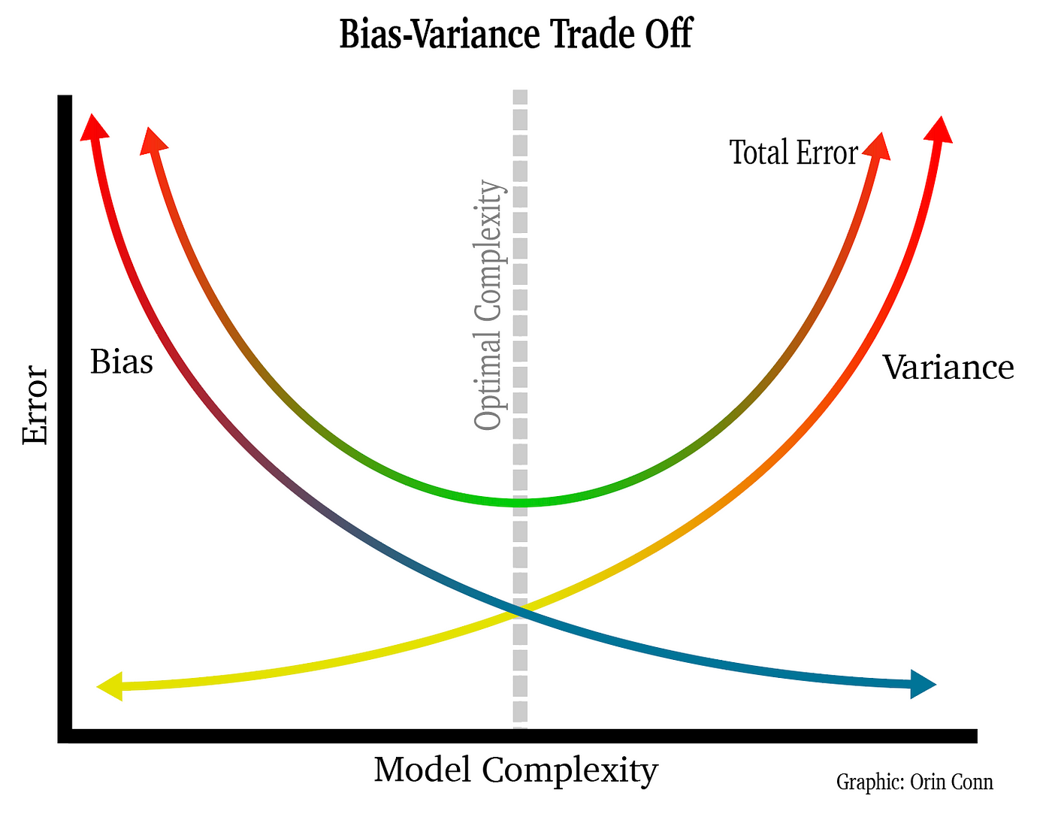
The Bias-Variance trade-off
You can’t, but you may reach a reasonable compromise
Master in Quantitative Economic Analysis MQuEA
Universidad Autónoma de Madrid

Slide 19
Main challenges in Machine Learning practice
Insufficient quantity of training data
Non-representative training data
Poor quality data
Irrelevant features
Overfitting training data
Underfitting training data
Master in Quantitative Economic Analysis MQuEA
Universidad Autónoma de Madrid

Slide 20
Take-home messages
ML is about making computers getting better at some tasks by learning from data instead of coding specific rules
There are many different ML systems: supervised or not, batch or online, instance-based or model-based
Non-parametric models have parameters that cannot be learnt from the data. These methods need to be tuned
Algorithms learn from a training dataset. They are evaluated on “new” data, a testing dataset
Flexible models can adapt better to any data structure but are less accurate. However, less flexible models are more interpretable
Variance in a model is a bad thing, but one cannot reduce it without increasing its bias (making more error)
Challenges in ML practice are mainly related to data, and not that much to the methods
Master in Quantitative Economic Analysis MQuEA
Universidad Autónoma de Madrid

